Slide 1
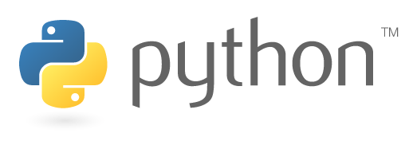
UNIT-II
Control Statements

Slide 2
Topics covered
CONTROL STATEMENTS:
The if Statement
if…else
if … elif … else statement
while loop
for loop
Infinite loop
Nested Loops
The else suite
Break statement
continue statement
pass statement
assert and return statement

Slide 3
Control Statements
program are normally executed line by line this type of execution is called “sequential execution “
A python program to calculate the area of a circle.
# to find the area of a circle
PI=3.14
r = float(input('Enter radius: '))
area = PI * (r**2) #pi is a constant in math module
print('Area of circle= ',area)
If we consider the output of the above program, we can understand that the statement written in are executed one by one by the python interpreter .this is called sequential execution.

Slide 4
Control Statements
To develop critical programs, the programmer should be able to change the flow of execution as needed by him.
For example , the programmer may wish to repeat a group of statements several times or be may want to directly jump from one statement to another statement in the program.
For this purpose , we need control statements.
Control statements are statements which control or change the flow of execution . The following are the control statements available in python:
if statement
if else statement
if elif else statement
while loop
for loop
Infinite loop
Nested loop
else suite
break statement
continue statement
pass statement
assert statement
return statement
please NOTE that the switch , do..while statement found in many language like C and Java but is not available in python.

Slide 5
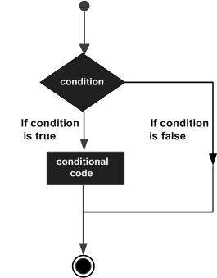
if Statements
This statement is used to execute one or more statement depending on whether a condition is true or not.
The syntax of correct format of if statement is given below
if condition:
statements
we can write one or more statements after colon (:)
A python program to express a digit in a word
# understanding the if statement
num=1
if num==1:
print("one")
Output:
c:\>python Demo.py
one

Slide 6
if Statements
Python programming language assumes any non-zero and non-null values as TRUE, and if it is either zero or null, then it is assumed as FALSE value.
We can also write a group off statements after colon.
The group of statements in python is called a suite.
While writing a group of statements ,we should write them all with proper indentation.
Indention represents the space left before the statements .the default indention used in python is 4 spaces.
A python program to display a group of messages when the condition is true.
#understanding if statement
str = 'yes'
if str == 'yes':
print("yes")
print("Ths is what you said")
print("your response is good")

Slide 7
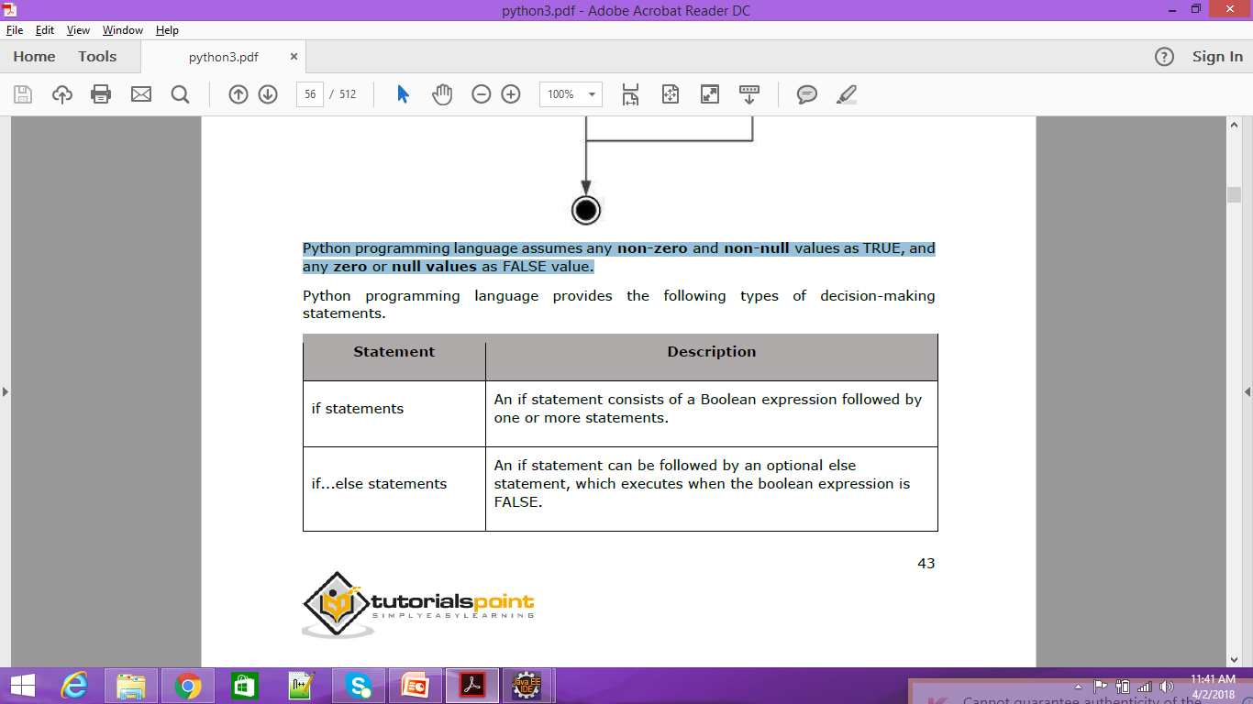
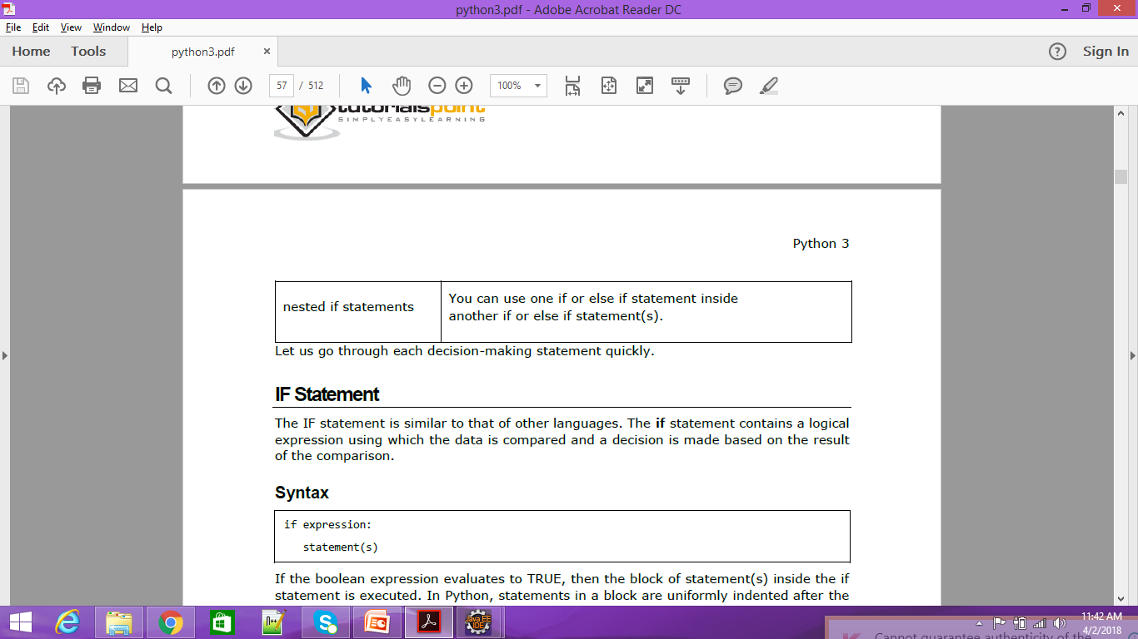
if Statements

Slide 8
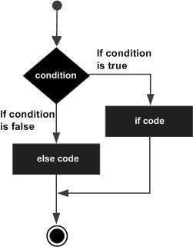
if….else Statements
The if….else statement execute a group of statements when a condition is true;
Otherwise, it will execute another group of statements .
the syntax of if…else statement is given below:
if condition:
statements1
else:
statements2
A python program to test whether a number is even or odd.
# to know if a given number is even or odd
x=10
if x%2==0:
print(x, "is a even number")
else:
print(x, "is a odd number“)

Slide 9
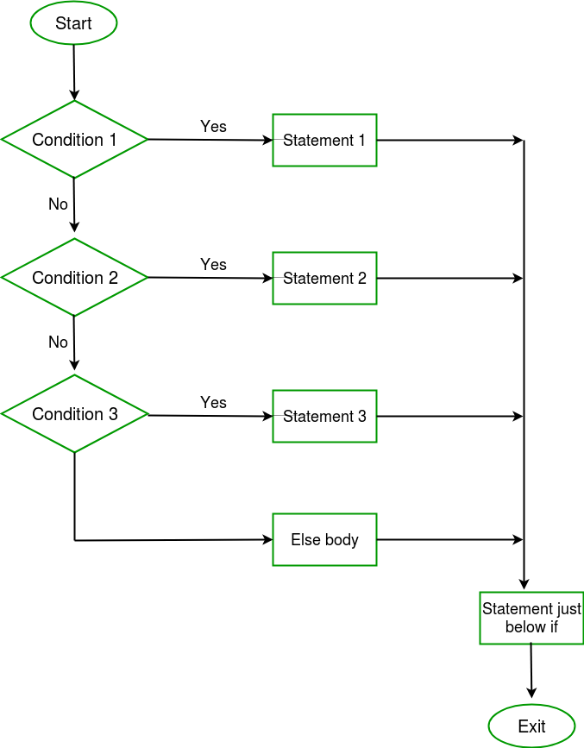
if….elif..else Statements
Sometimes , the programmer has to test multiple conditions and execute statements depending on those conditions.
If….elif….else statement is useful in such situations.
Consider the following syntax of if…elif….else statement:
if condition1:
statement1
elif condition2:
statement2
elif condition3:
statement3
else:
statement4
. The statements1, statements2,… represent one statement or a suite. The final ‘else’ part is not compulsory. It means, it is possible to write if….elif statement, without ‘else’ and statements4.

Slide 10
if….elif..else Statements
A python program to know if a given number is zero, positive or negative.
#to know if a given number is zero or +ve or -ve
num = -5
if num==0:
print(num,"is zero")
elif num>0:
print(num,"is positive")
else:
print(num,"is negative“)
A program to accept a numeric digit from keyboard and display week day
# to display a numeric digit in words
x = int(input('enter a digit: '))
if x==0:
print(“Sunday")
elif x==1:
print(“Monday")
elif x==2:
print(“Tuesday")
elif x==3:
print(“Wednesday")
elif x==4:
print(“Thursday")
elif x==5:
print(“Friday")
elif x==6:
print(“Saturday") #else is not compulsory

Slide 11
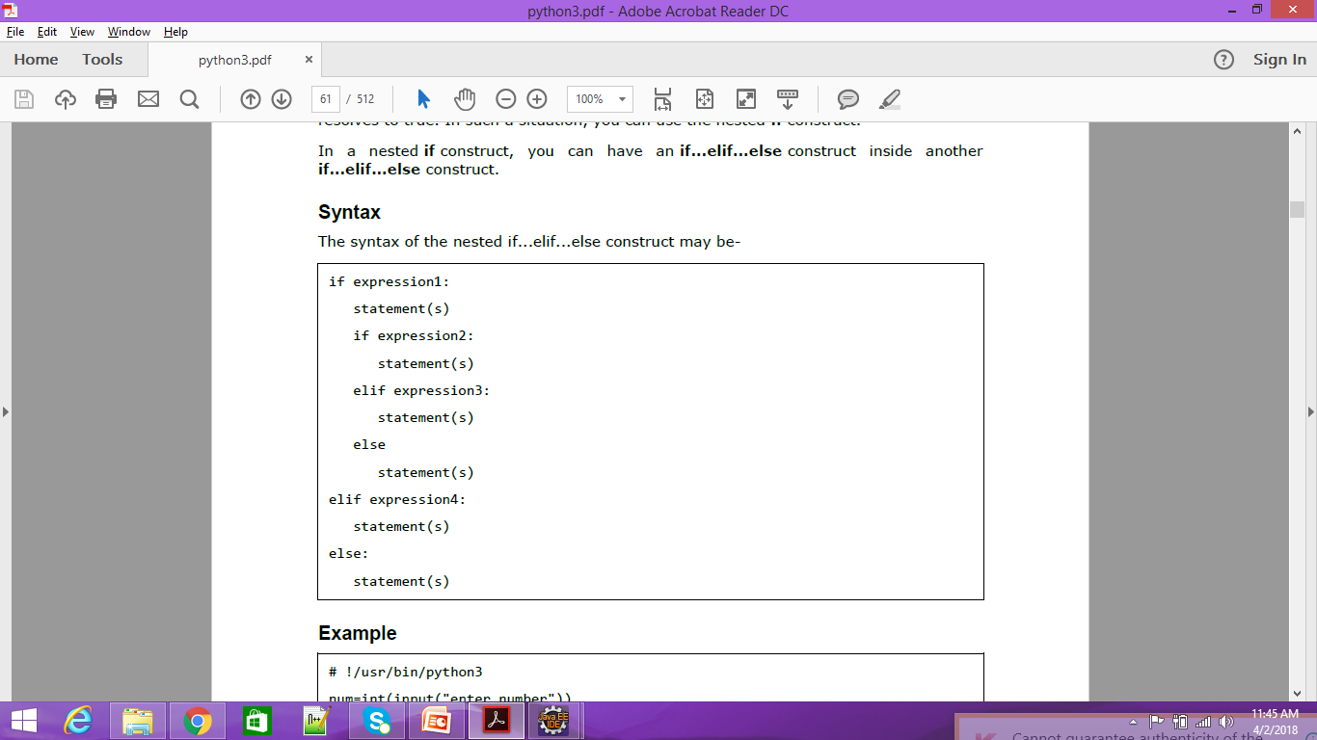
Nested if… elif …else Statements

Slide 12
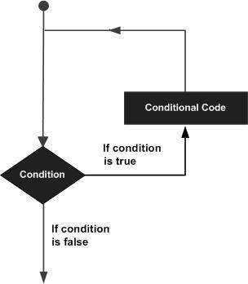
Loop Statements
A loop statement allows us to execute a statement or group of statements multiple times.
The following diagram illustrates a loop statement −
following types of loops to handle looping requirements.
1 while loop : Repeats a statement or group of statements while a given
condition is TRUE. It tests the condition before executing the loop
body.
2 for loop : Executes a sequence of statements multiple times and abbreviates
the code that manages the loop variable.
3 nested loops: You can use one or more loop inside any another while or for
loop.

Slide 13
While Loop Statements
while loop: Executes a group of statements as long as a condition is True.
good for indefinite loops (repeat an unknown number of times)
Syntax:
while condition:
statements
Example:
number = 1
while number < 200:
print (number)
number = number * 2
Output:
1 2 4 8 16 32 64 128
A python program to display numbers from 1 to 10 using while loop.
# to display numbers from 1 to 10
x = 1
while x<=10:
print(x)
x+=1
print (“End”)

Slide 14
for Loop Statements
The for loop is useful to iterate over the elements of a sequence.
It means, the for loop can be used to execute a group of statements repeatedly depending upon the number of elements in the sequence.
The for loop can work with sequence like list, tuple, range etc.
the syntax of the for loop is given below:
for var in sequence:
Statements
Example:
for x in range(1, 6):
print (x, "squared is", x * x)
Output:
1 squared is 1
2 squared is 4
3 squared is 9
4 squared is 16
5 squared is 25

Slide 15
for Loop Statements
Range
The range function specifies a range of integers:
range(start, stop) - the integers between start (inclusive) and stop (exclusive)
It can also accept a third value specifying the change between values.
range(start, stop, step) - the integers between start (inclusive) and stop (exclusive) by step
Example:
for x in range(5, 0, -1):
print x
print "Blastoff!"
Output:
5
4
3
2
1
Blastoff!

Slide 16
for Loop Statements
A python program to display characters of a string using for loop.
# display each character from a string
str = ‘Hello’
for ch in str:
print(ch)
Output:
C :/> python Demo.py
H
e
l
l
o
A program to display the element of a list using for loop.
# take a list of elements
List = [10,20.5, ‘A’ ‘America’]
# display each statement from the list
for element in list:
print(element)
output:
C :/> python Demo.py
10
20.5
A
America

Slide 17
Infinite Loops Statements
An infinite loop is a loop that executes forever.
following is an example for an infinite loop.
i=1
while i<=10:
print(i)
it will display the value 1 forever.
To stop the program, we have press Control+C at system prompt.
Another way of creating an infinite loop is to write ‘True’ in the condition part of the while loop so that the python interpreter thinks that the condition is true always and hence executes it forever.
See the example:
while (True):
print(“Hai”)

Slide 18
Nested Loops Statements
It is possible to write one loop inside another loop.
For example,
we can write a for loop inside a while loop for a for loop inside another for loop.
Such loops are called ‘nested loops’.
Consider the following example
for i in range(3): #i value are from 0 to 2
for j in range(4): #j value are from 0 to 3
print(‘i=’, i, ‘\t’, ‘j=’,j) # display i and j values
When outer for loop is executed once, the inner for loop is executed for 4 times. It means , when I value is 0,j values will change from 0 to 3. So, print() function will display the following output;
i = 0 j = 0
i = 0 j = 1
i = 0 j = 2
i = 0 j = 3

Slide 19
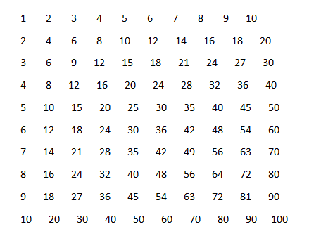
Nested Loops Statements
A python program to display number from 1 to 100 in a proper format.
#display numbers from 1 to 100 in 10 rows and 10 cols
for x in range(1,11): # no of rows
for y in range(1,11): # no of columns
print('{:8}'.format(x*y),end='') #each column size is 8
print()

Slide 20
The else suite
In python, it is possible to use ‘else’ statement along with for loop or while loop in the form shown in table
The statements written after ‘else’ are called suite.
The else suite will be always executed irrespective of the statements in the loop are executed or not.
for with else | while with else
for(var in sequence): statements else: Statements | while(condition): statements else: statements

Slide 21
The else suite
For example,
for i in range(5):
print(“yes”)
else:
print(“no”)
this will display the following output:
yes
yes
yes
yes
yes
no
for i in range(0):
print(“yes”)
else:
print(“no”)
this will display the following output:
no

Slide 22
The else suite
For example,
count =0
while count < 5:
print(count , “is less than 5”)
count+=1
else:
print(count, “is not less than 5”)

Slide 23
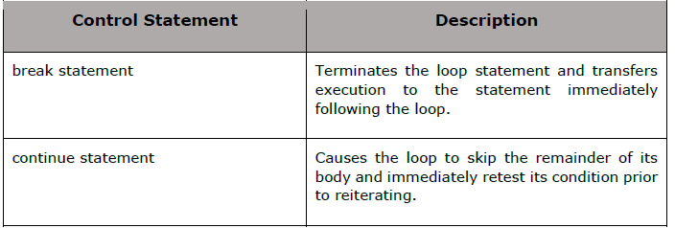
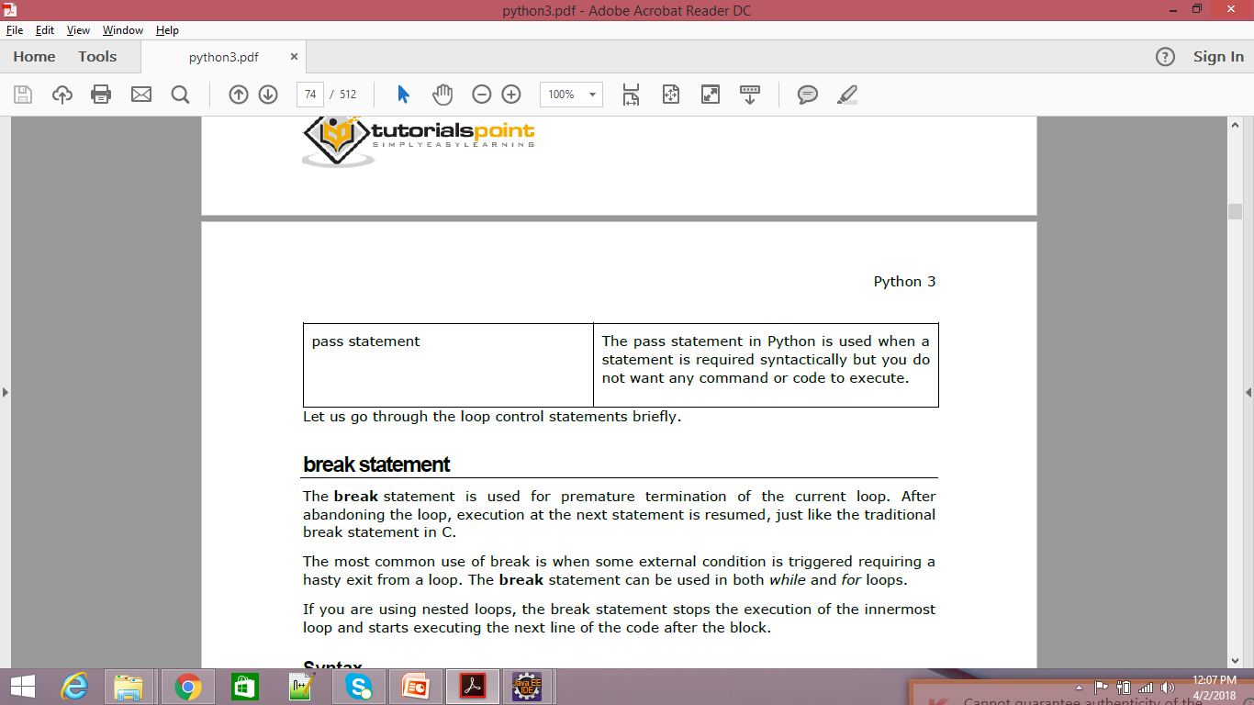
Loop Control Statements

Slide 24
Break statement
The break statement can be used inside a for loop or while loop to come out of the loop.
When ‘break ‘ is executed the python interpreter jumps out of the loop to process the next statement in the program.
We have used break inside for loop. When the element is found. It would break the for loop and comes out .we can also use break inside a while loop.
A python program to search for an element in the list of elements ?
#searching for an element in a list
group1 = [1,2,3,4,5] #take a list of elements
search = int(input('enter element to search: '))
for element in group1:
if search ==element:
print('element found in group1')
break #come out of for loop
else:
print('element not found in group1') #this is else suite

Slide 25
Break statement
A python program to display numbers from 10 to 6 and break the loop when the number about to display is 5.
#using break to come out of while loop
x=10
while x>=1:
print(' x=',x)
x-=1
if x==5: #if x is 5 then come out from while loop
break
print("out of loop")

Slide 26
Continue statement
The continue statement is used in a loop to go back to the beginning of the loop.
It means, when continue is executed, the next repetition will start, when continue is executed, the subsequent statement in the loop are executed.
A python program to display numbers from 1 to 5 continue statement:
#using continue to execute next iteration of while loop
x=0
while x<10:
x+=1
if x>5: #if x>5 then continue next iteration
continue
print('x=',x)
print("out of loop")
Output:
c:\python Demo.py
x= 1
x= 2
x= 3
x= 4
x= 5
out of loop

Slide 27
Pass statement
The pass statement does not do anything. It is used with ‘if’ statement or inside a loop to represent no operation.
We use pass statement when need a statement syntactically but we do not want to do any operation.
A python program to retrieve only negative number from a list of numbers.
#retrieving only negative numbers from a list
num = [1,2,3,-4,-5,-6,-7,-8,9]
for i in num:
if i>0:
pass # we are not interested
else:
print(i) #this is what we need
output:
c:\>python Demo.py
-4
-5
-6
-7
-8

Slide 28
Assert statement
The assert statement is useful to check if a particular condition is fulfilled or not. The syntax is as follows:
assert expression, message
in the above syntax, the ‘message’ is not compulsory.
Let’s take an example. If we want to assure that the user should enter only a number greater than 0,
we can use assert statement as:
assert x>0, “wrong input entered”
in this case, the python interpreter checks if x>0 is true or not.
If it is true, then the next statement will execute,
else it will display AssertionError along with the message “Wrong input entered”.

Slide 29
Assert statement
A program to assert that the user enters a number greater than zero.
# understanding assert statement
x = int (input(‘Enter a number greater than 0: ‘))
assert x>0, “Wrong input entered”
print (‘U entered: ‘,x)
Output:
C:\>python Demo.py
Enter a number greater than 0: 5
U entered : 5
C:\>python Demo.py
Enter a number greater than 0: -2
Traceback (most recent call last):
File “Demo.py”, line 3, in <module>
Assert x/.0, “wrong input entered”
AssertionError: Wrong input entered

Slide 30
Assert statement
The ‘AssertionError’ shown in the above output is called an exception.
An exception error that occurs during runtime.
To avoid such type of executions, we can handle them using ‘try…except’ statement.
After ‘try’ we use ‘assert’ and after ‘except’, we write the exception name to be handled.
In this except block, we write the statements that are executed in case of exception.

Slide 31
Assert statement
A python program to handle the AssertionError exception that is given by assert statement.
# to handle AssertionError raised by assert
x = int(input(‘Enter a number greater than 0: ‘))
try:
assert(x>0) # exception may occur here
print(‘U entered: ‘,x)
except AssertionError:
print(“Wrong input entered”) # this is executed in case of exception
Output:
C:\>python Demo.py
Enter a number greater than 0: -5
Wrong input entered

Slide 32
Return statement
Return statement we will discuss when we deal with functions.

Slide 33

www.mallareddyuniversity.ac.in
Notes:
You can safely remove this slide. This slide design was provided by SlideModel.com – You can download more templates, shapes and elements for PowerPoint from http://slidemodel.com
‹#›

